Slide 1

Analyzing Student Credit Utilization at CATalyst Studios, University of Arizona Libraries
Ashwini R Jannu Graduate Student & Student Assistant, University of Arizona

Slide 2

Research Problem
Understanding how students at CATalyst Studios utilize their allocated credits:
• Which semesters see the highest usage?
• Which departments have the highest credit utilization?
• Are students maximizing their available credits effectively?
• How much does this cost CATalyst Studios each semester?

Slide 3




Research Tools
• Data Cleaning and Analysis: Excel, Python( Pandas)
• Data Extraction: Regex (to extract balance from unstructured comments)
• Visualization: Python (Matplotlib, Seaborn)
• Planned Dashboard: Tableau

Slide 4
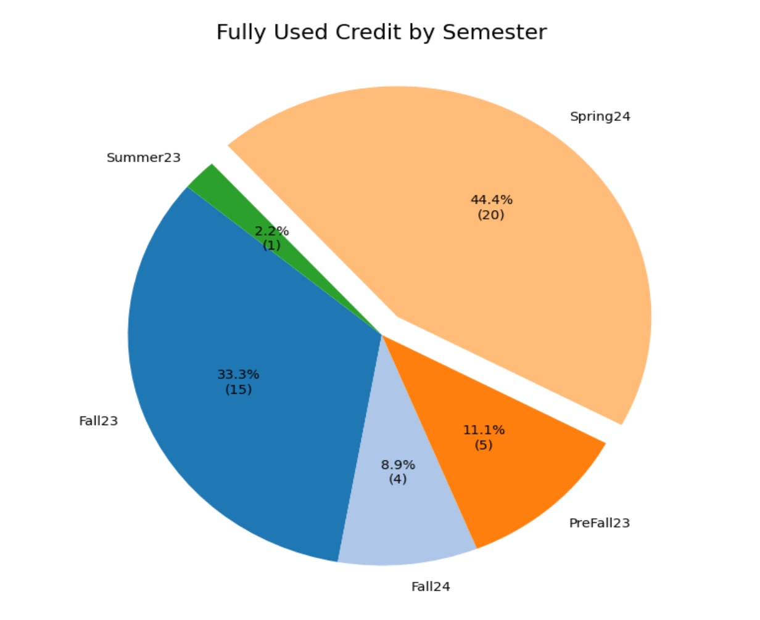
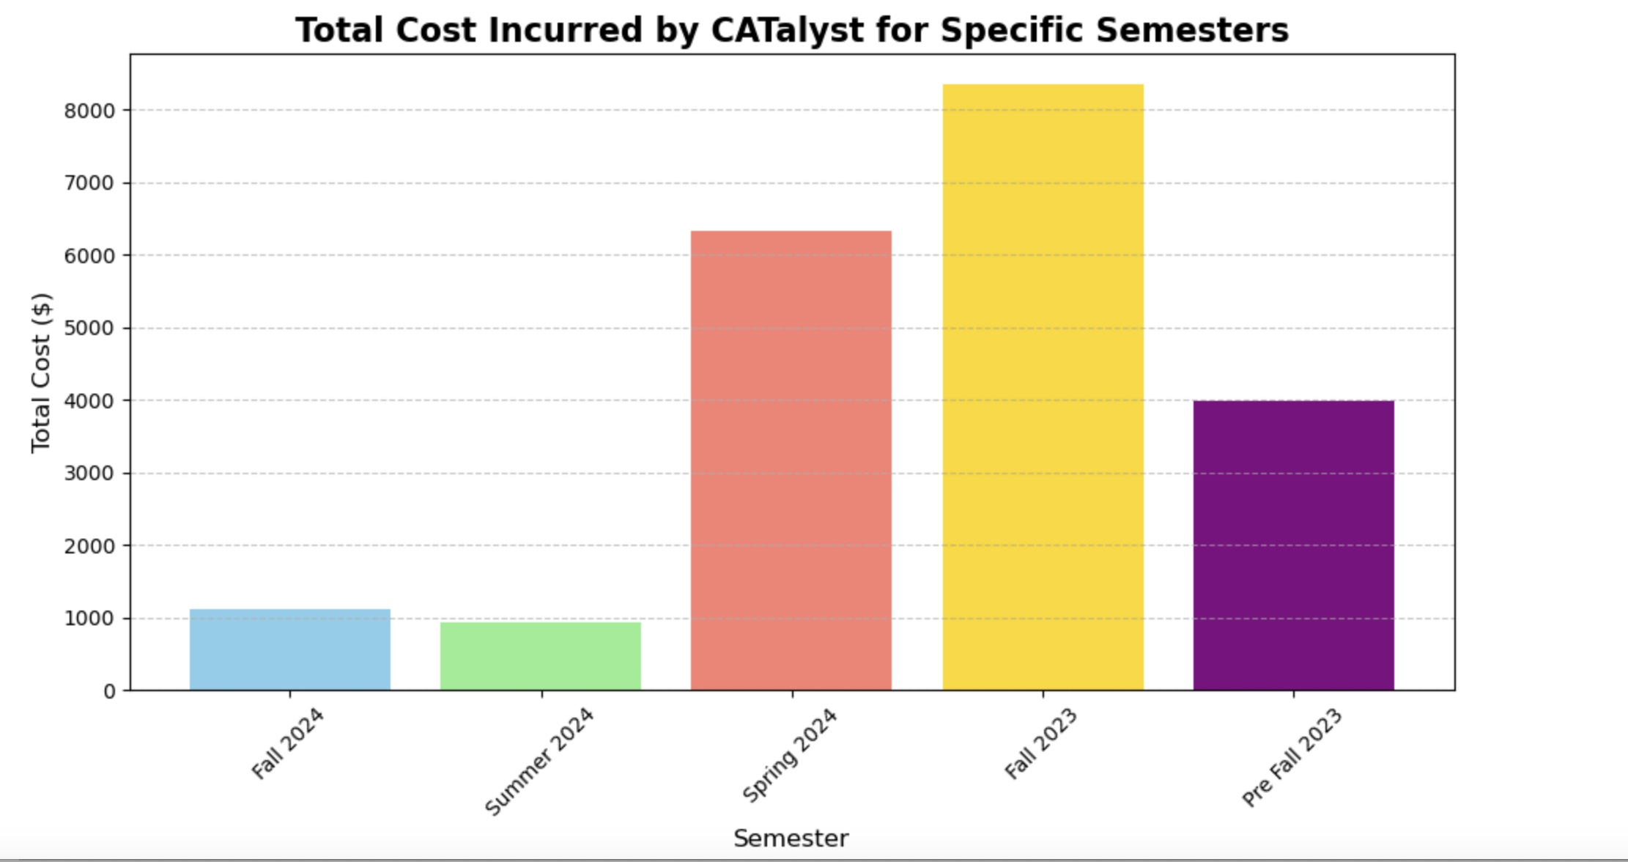
Research Findings
1. Spending Patterns: The average spending per semester showed consistent usage, with Fall 2024 having the highest average spending.
2. Fully Used Credits: Spring 2024 had the highest number of students exhausting their credits.
3. Departmental Trends: ‘Marketing MS’ students had the highest average spending, while ‘Architecture – BA’ students were most likely to fully use their credits.
4. Financial Impact: Semester-wise costs were approximately $1,111 for Fall 2024, $6,325 for Spring 2024, and $937 for Summer 2024.

Slide 5

Thank You!

